Slide 1
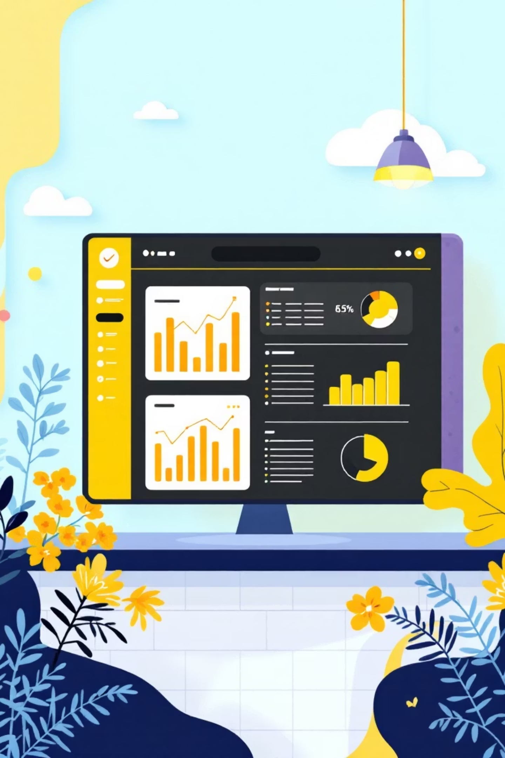
Customer Shopping Behavior Analysis
Uncovering insights from 3,900 purchases to guide strategic business decisions

Slide 2

Dataset at a Glance
3,900
18
$59.76
3.75
Total Purchases
Data Points
Avg Purchase
Avg Rating
Transactions analyzed
Features per transaction
Per transaction
Customer satisfaction
Comprehensive dataset covering demographics, purchase details, and shopping behavior across multiple categories

Slide 3

Data Preparation Journey
01
Data Loading & Exploration
Imported dataset, checked structure with pandas
02
Missing Data Handling
Imputed 37 missing review ratings using category medians
03
Feature Engineering
Created age groups and purchase frequency metrics
04
Database Integration
Loaded cleaned data into PostgreSQL for analysis

Slide 4
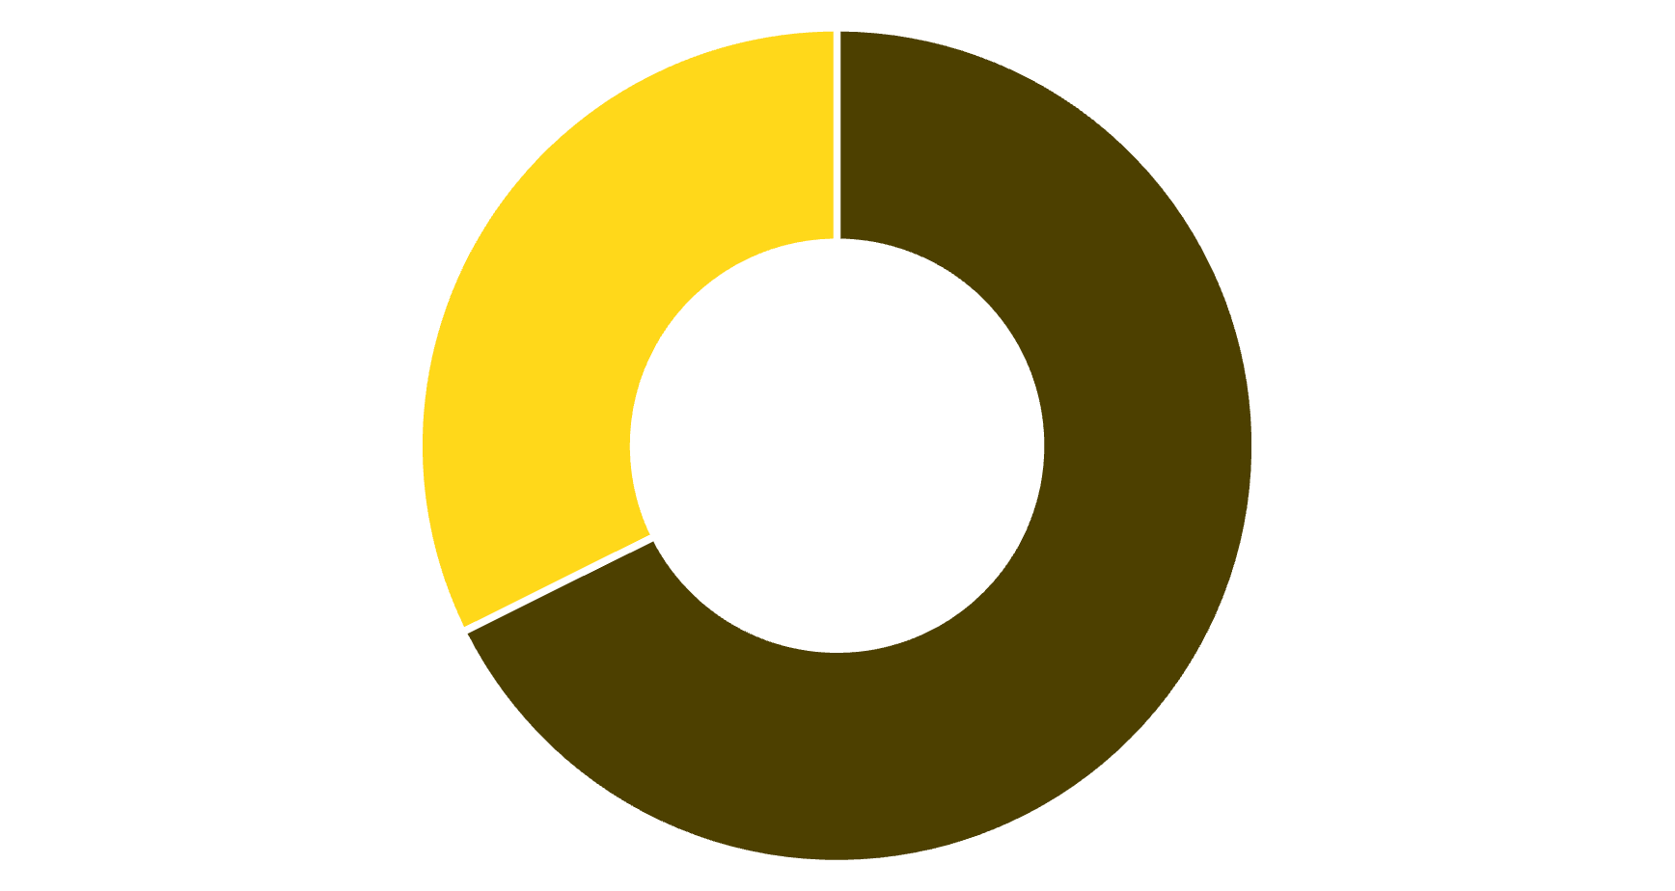


Revenue Insights: Gender & Subscriptions
Revenue by Gender
Subscription Status
27%
Subscribers
Male
Female
Male customers generate 68% of total revenue
73%
Non-subscribers
Avg spend: Subscribers $59.49 vs Non-subscribers $59.87

Slide 5
Top Performing Products
1
2
3
Gloves
Sandals
Boots
Highest rated: 3.86 stars
Second best: 3.84 stars
Strong performer: 3.82 stars
4
5
Hat
Skirt
Popular choice: 3.80 stars
Top five: 3.78 stars

Slide 6
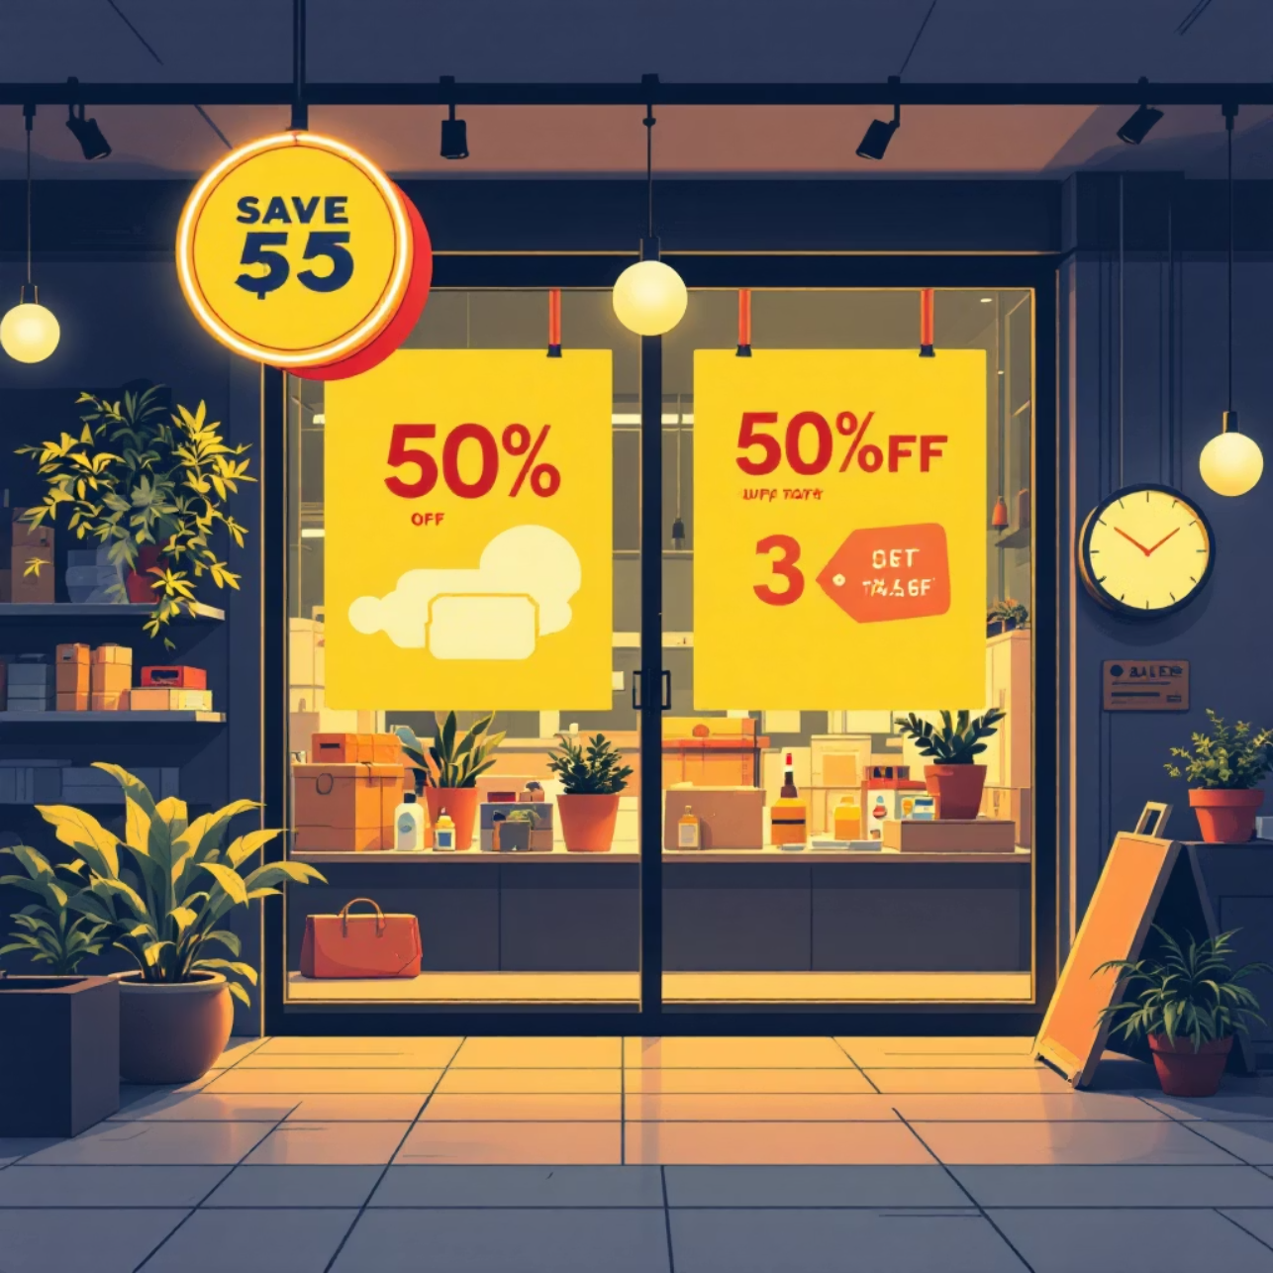

Discount Strategy Analysis
High-Spending Discount Users
839 customers used discounts but still spent above average
Opportunity to optimize discount targeting
Most Discounted Products
Hat: 50% discount rate
Sneakers: 49.66%
Coat: 49.07%
Sweater: 48.17%
Pants: 47.37%
Balance sales boosts with margin control—review discount policy for profitability

Slide 7



Customer Segmentation
New
1
83 customers
Returning
2
701 customers
Loyal
3
3,116 customers
80% of customers are loyal—focus on moving returning customers into this segment

Slide 8
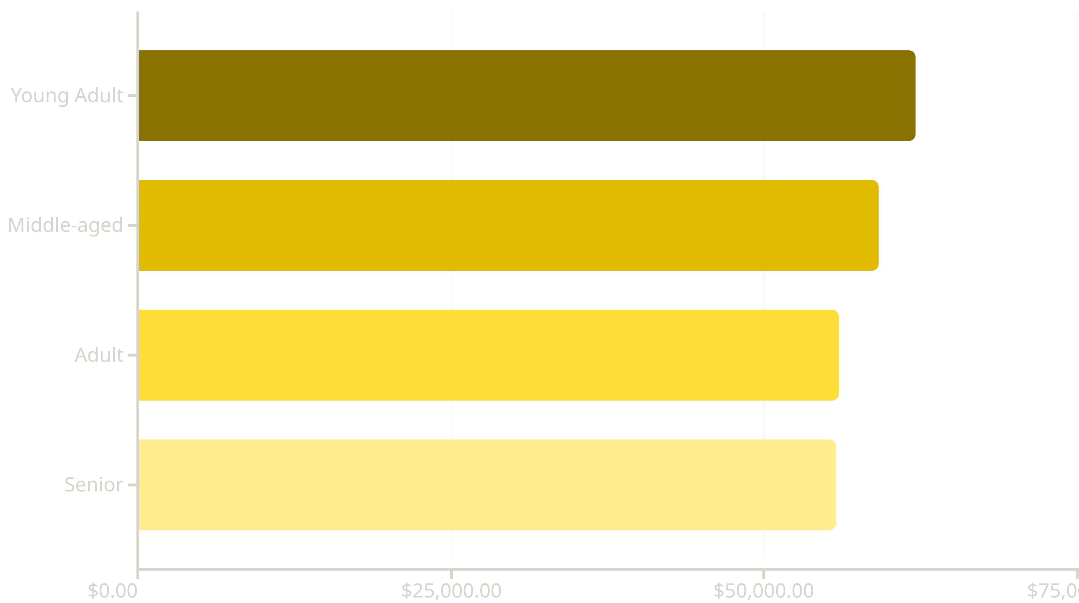
Revenue by Age Group
Young adults lead revenue generation—target marketing efforts accordingly

Slide 9

Shipping & Category Performance
Shipping Type Impact
Top Categories
Express: $60.48 avg purchase
Clothing: Highest revenue & sales
Standard: $58.46 avg purchase
Accessories: Strong second
Express shipping users spend 3.5% more
Footwear: Consistent performer
Outerwear: Seasonal opportunity

Slide 10

Strategic Recommendations
Boost Subscriptions
Loyalty Programs
Optimize Discounts
Promote exclusive benefits to convert 73% non-subscribers
Reward repeat buyers to grow loyal segment
Balance promotions with margin control
Highlight Top Products
Targeted Marketing
Feature high-rated items in campaigns
Focus on young adults and express shipping users

